Slide 1



Decoding Uncertainty: An Introduction to Probability
Pro-Tip: Probability is not just about measuring chance; it is the fundamental mathematical language used to quantify uncertainty in all data-driven fields.

Slide 2
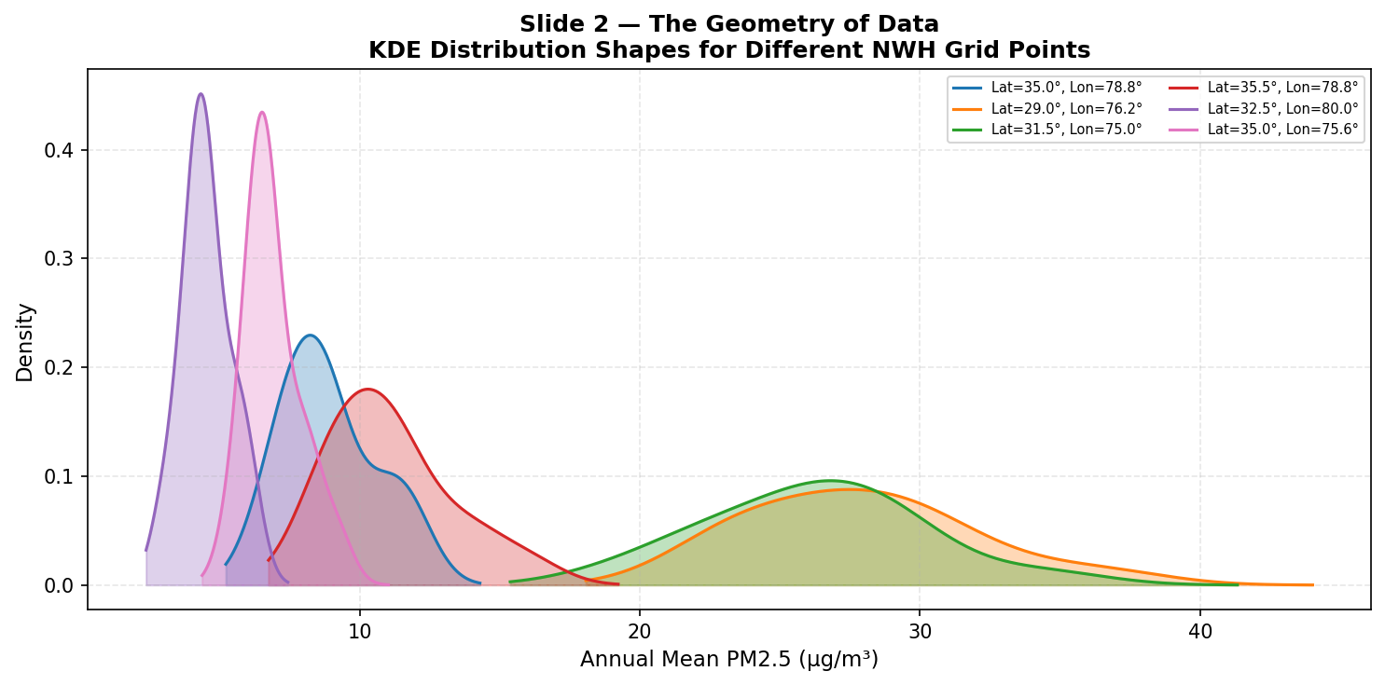
Introduction to Probability: The Geometry of Data
Probability quantifies uncertainty, shifting analytics from looking at what happened to what is likely.
Every variable in the real world from human heights to rainfall—has a shape, known as its distribution.
Understanding these hidden distribution shapes reveals patterns impossible to see in raw data alone.
Pro-Tip: Don’t just analyze the data points; analyze the engine that generated them.
Probability is that engine.

Slide 3
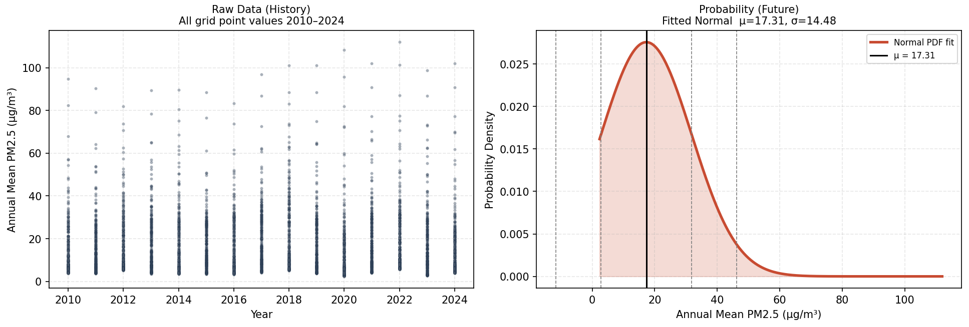
The ‘Why’: Moving Beyond Raw Data
The sheer volume of modern data makes it impossible to extract meaningful information simply by scanning raw values.
A fundamental axiOm of Data Analytics is that all data inherently follows (or is a sample of) a mathematical distribution.
Where there is a distribution, there is probability—acting as the core foundation for all statistical inference and generalization.
Pro-Tip: Raw data is history; probability is the future. If you want to predict, you must embrace the distribution.

Slide 4
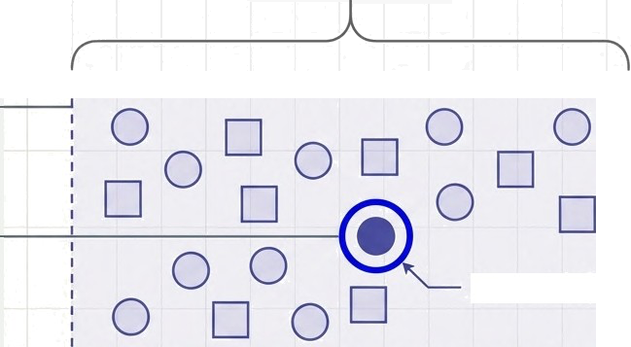
The Probability Fundamental Concepts
Experiment: An action with an uncertain outcome (e.g., tossing a coin or measuring a daily temperature).
Sample Space (S): The definitive set of all possible outcomes for a given experiment (e.g., S = {Heads, Tails}).
Event (E): A specific subset of the sample space that we are trying to measure the likelihood of occurring.
Experiment
Event (E)
Pro-Tip: Always define your Sample Space (S) before calculating anything. A wrong S guarantees a wrong probability.

Slide 5

The Probability Fundamental Concepts
0
1
0 ≤ P ≤ 1
(Impossible)
(Certain)
Experiment | Sample Space | Event (E)
An action yielding uncertain outcomes Eg. tossing a coin | The absolute set of all possible outcomes. S- {Head, Tail} | A specific subset of the sample space Event = {Heads}
Pro-Tip: Always define your Sample Space (S) before calculating anything. A wrong S guarantees a wrong probability.

Slide 6


Discrete vs. Continuous Random Variables
Discrete
Discrete Variables: Characterized by countable, distinct outcomes (
For example: number of emails per hour),
Modeled using a Probability Mass Function (PMF).
Continuous
Continuous Variables: Characterized by infinite potential outcomes within a range
For example: temperature
Modeled using a Probability Density Function (PDF).
Pro-Tip: The mathematical treatment of a variable defines your entire analytics pipeline. Always verify if your variable is genuinely continuous or just a highly granular discrete measurement

Slide 7
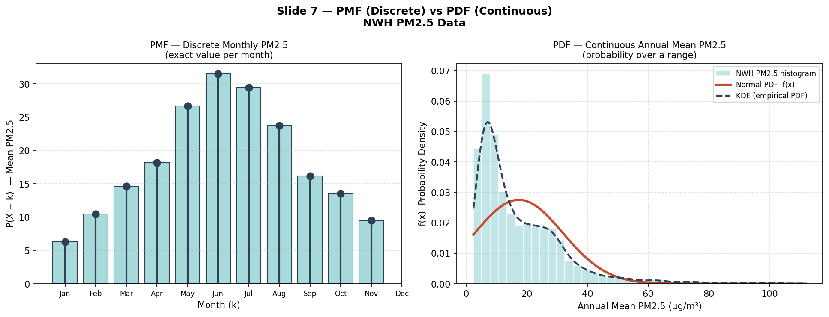
Mapping the Spread: Defining the Distribution
A distribution dictates exactly how the values of a random variable are spread out, providing a mathematical roadmap to calculate the likelihood of different outcomes.
PMF
While PMF, calculate the exact probability of X=k
PDF
PDFs calculate the probability of X falling within a specific continuous range.
Pro-Tip: If you can count it, use a PMF. If you have to measure it, use a PDF.

Slide 8
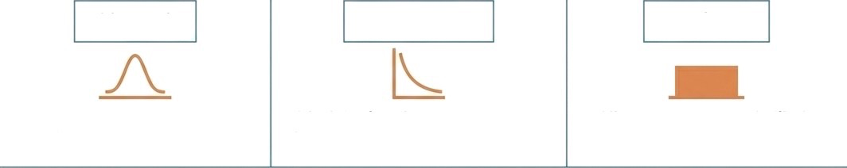



Type of Distributions
Continuous Distributions
Normal
Exponential
Uniform
Symmetric, bell shaped defined by 𝜇 and 𝜎
Models time between events: features memoryless property
All outcomes equally likely over a continuous range
Discrete Distributions
Bernoulli
Binomial
Poisson
Two Outcomes (Success / Failure)
Repeated Bernoulli trials
Models number of events in a fixed time/space
Pro-Tip: Don't just memorize the formulas. Memorize the physical data-generating processes behind these distributions so you know exactly when to deploy them in the wild.

Slide 9
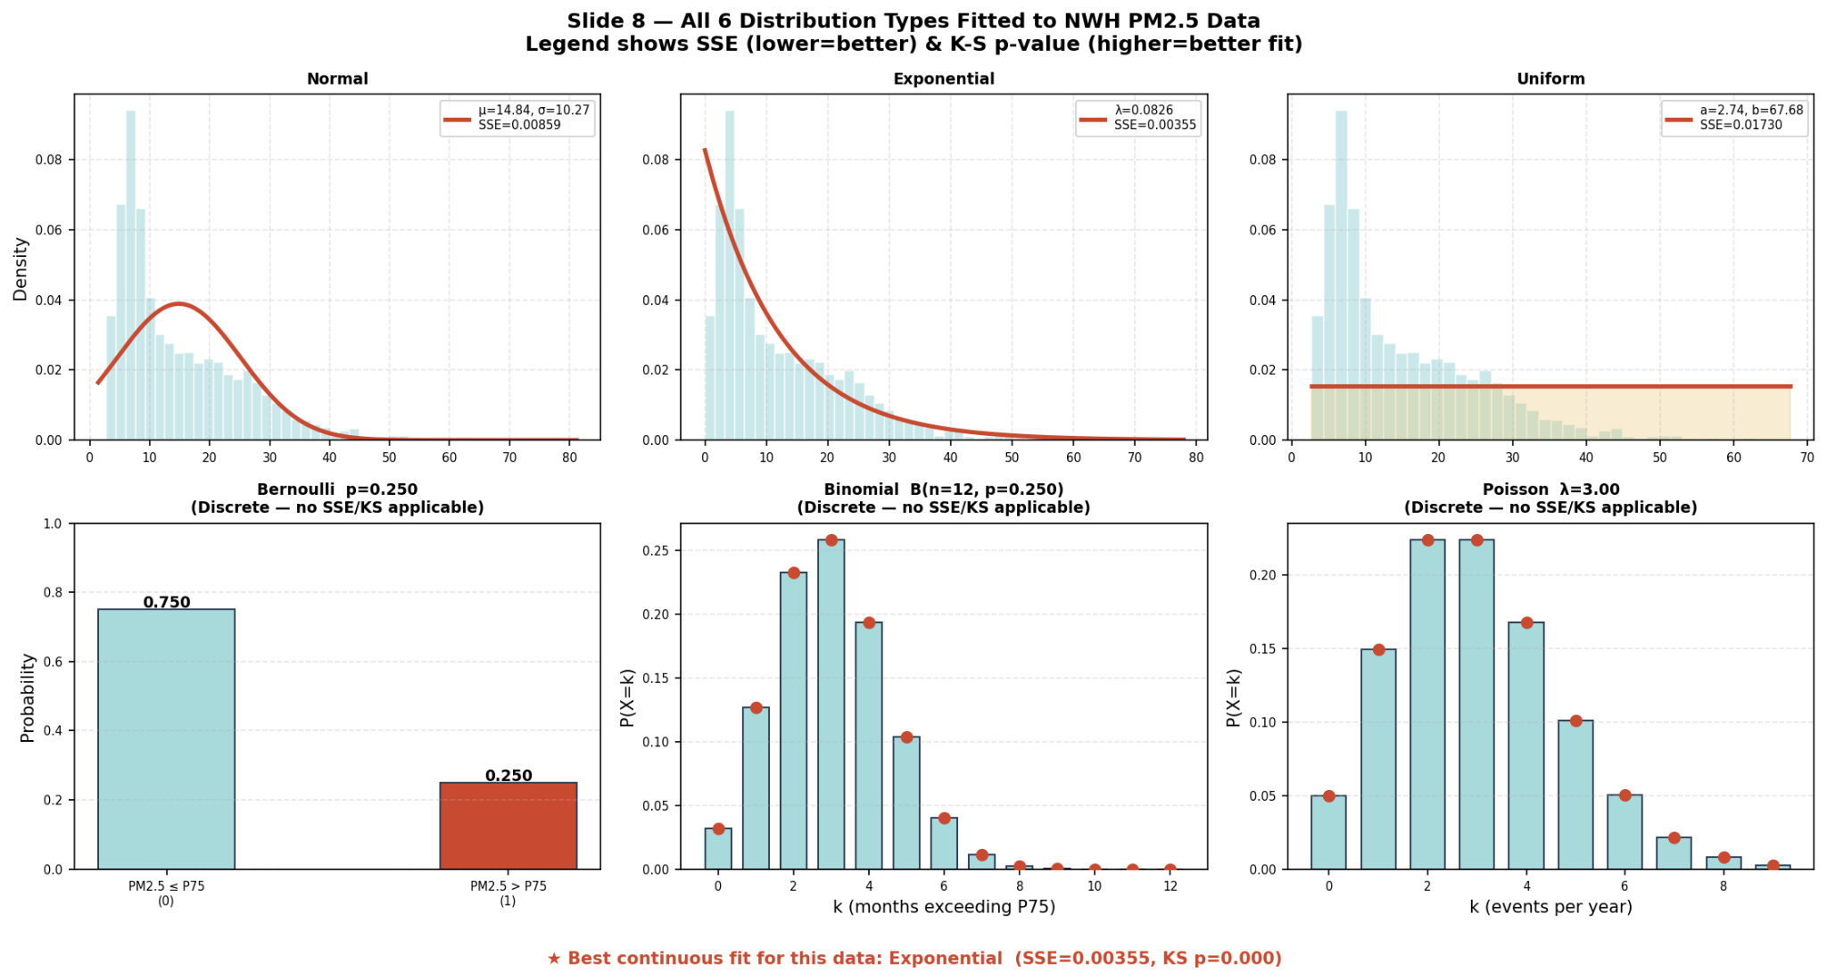
All distributions fitted to the real data

Slide 10

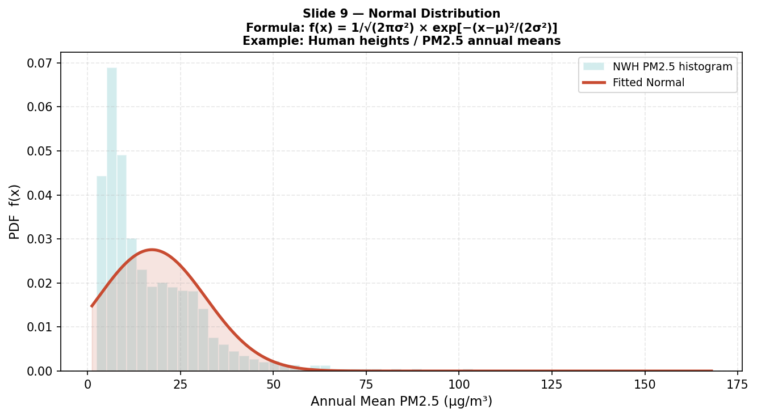

Normal Distribution
Core Concept: A symmetric, continuous bell- shaped curve fully defined by its center (𝜇) and spread (𝜎).
PDF Formula:
Example:
Human heights;
naturally occurring measurement errors
Pro-Tip: Thanks to the Central Limit Theorem, the Normal distribution serves as the default prior for aggregated errors in machine learning, even if underlying individual data points aren't normally distributed.

Slide 11
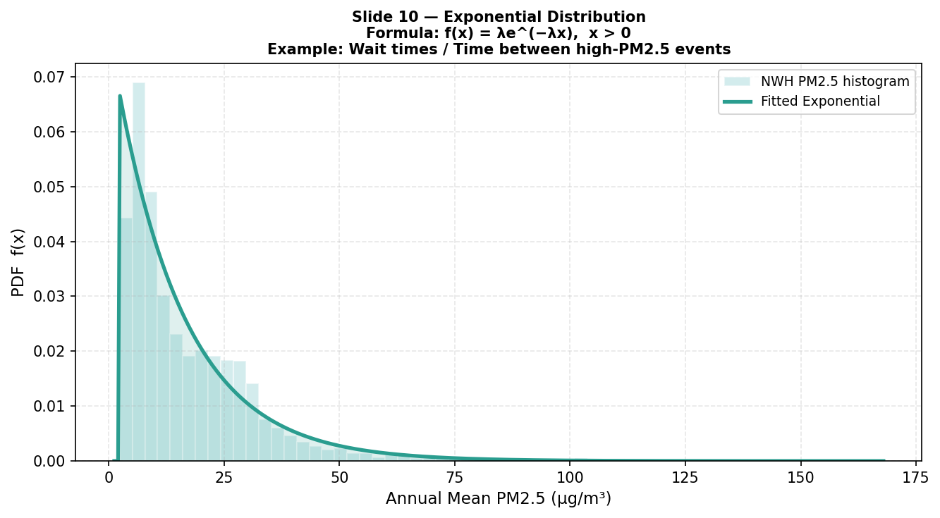

Exponential Distribution
Core Concept:
Models the continuous time passing between events in a Poisson process.
Features the unique memoryless property.
PDF Formula:
Example:
Wait times between ATM arrivals
Lifespan of electronic components
Pro-Tip: The defining memoryless property makes this mathematically elegant, but it is often a poor fit for biological lifespans (where distributions accounting for aging are preferred).

Slide 12
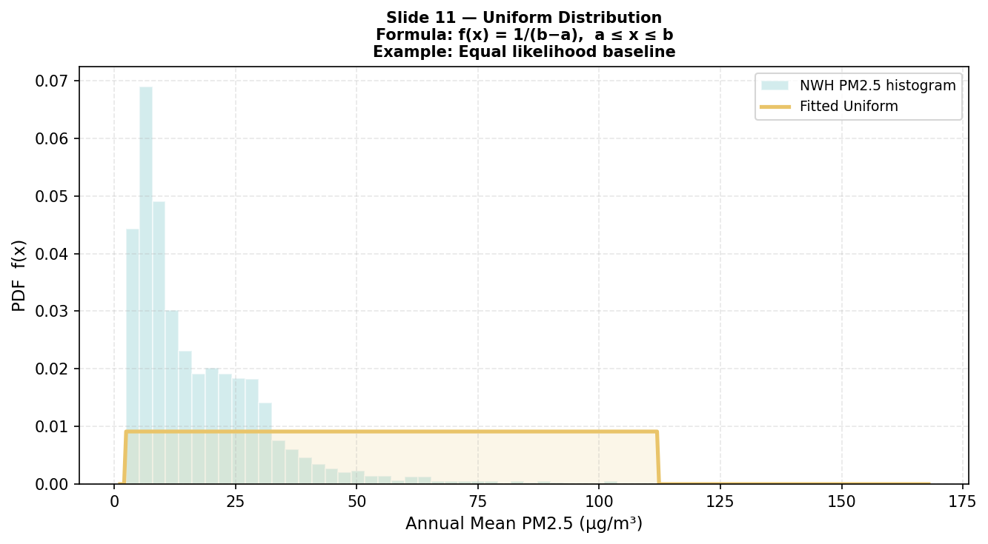

Uniform Distribution
Core Concept:
All outcomes are equally likely over a continuous range.
PDF Formula:
Example:
Picking a random number between 0 and 1
Pro-Tip: The constant probability density 1/(b−a) provides an elegant, unbiased baseline for bounded ranges. However, it is often a poor fit for natural phenomena where distributions with specific means and "tails" are required to model reality accurately

Slide 13
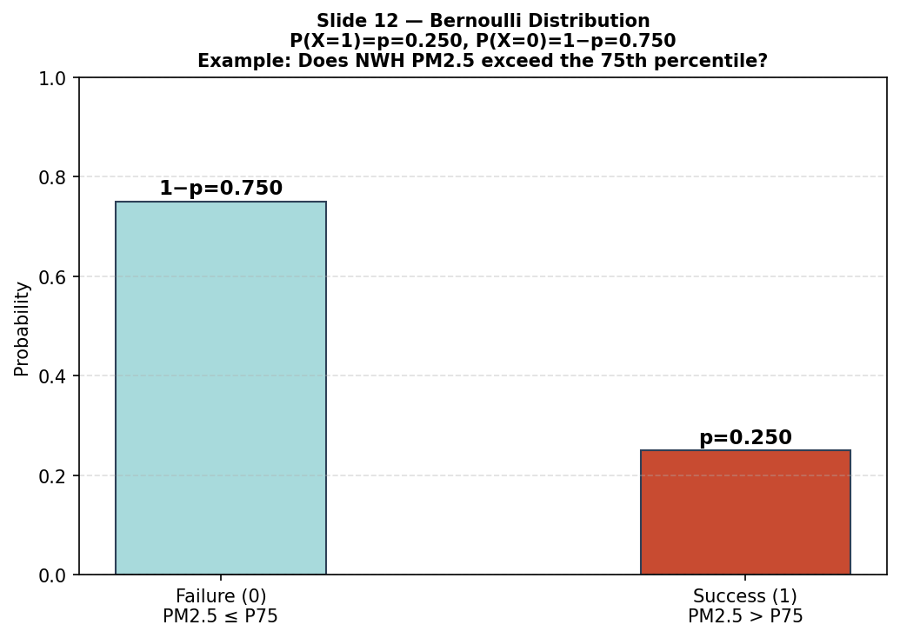
Bernoulli Distribution
Core Concept:
One single experiment resulting in exactly two outcomes: Success (1) or Failure (0).
PMF Formula:
P(X = 1) = p
P(X = 0) = 1-p
Example:
Tossing a biased coin
Predicting if a machine fails or not.
Pro-Tip: The Bernoulli distribution is the atomic unit of machine learning classification. Every logistic regression output is essentially modeling the parameter 'p’ of a Bernoulli trial.

Slide 14
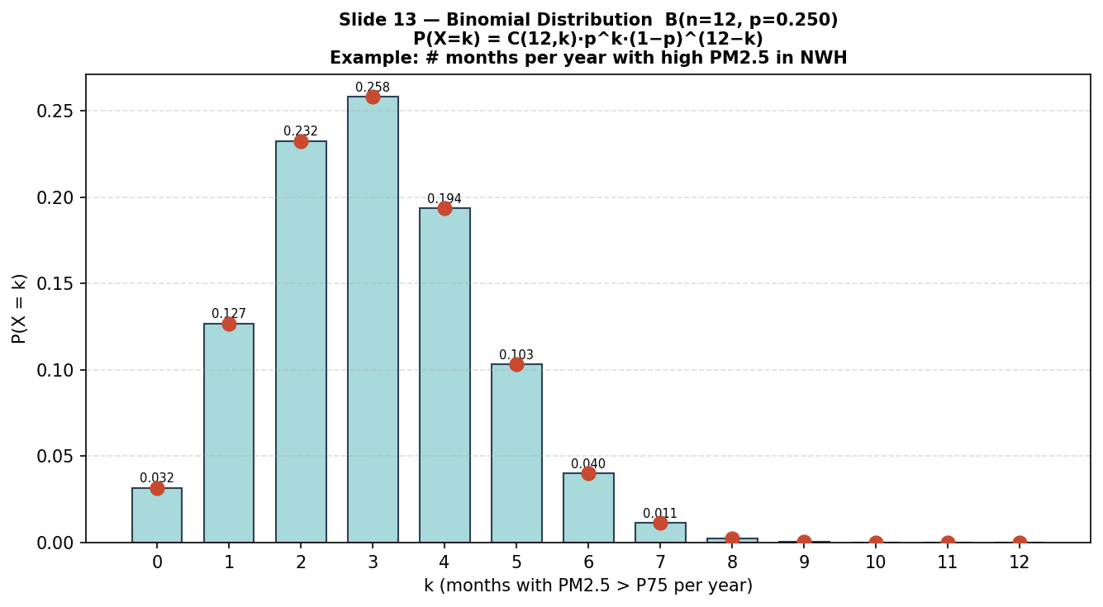

Binomial Distribution
Core Concept:
The sum of n independent Bernoulli trials.
PMF Formula:
Example:
Number of Heads in 10 coin tosses
Number of customers who buy out of 100 contacted
Pro-Tip: When the number of trials (n) is very large and the probability of success (p) is very small, the Binomial distribution seamlessly approximates the computationally lighter Poisson distribution.

Slide 15
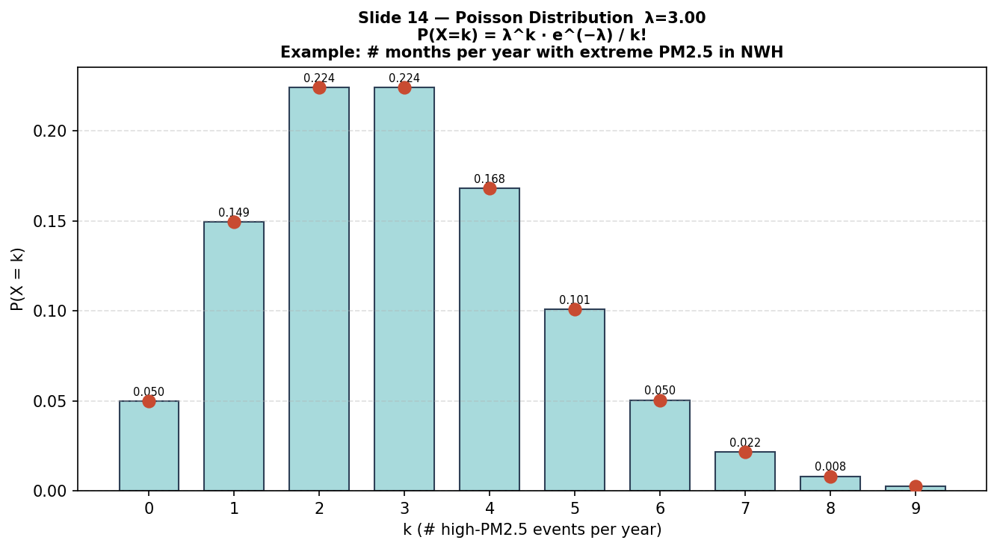

Poisson Distribution
Core Concept:
Models the exact count of events occurring in a fixed interval of time or space,
Assuming events happen independently.
PMF Formula:
Example:
Number of calls to call center in 1 hour
Number of typos per page in a book
Pro-Tip: The strict assumption of "independent events" is Poisson's Achilles’ heel. If events cluster (like viral retweets), upgrade to the Negative Binomial distribution.

Slide 16
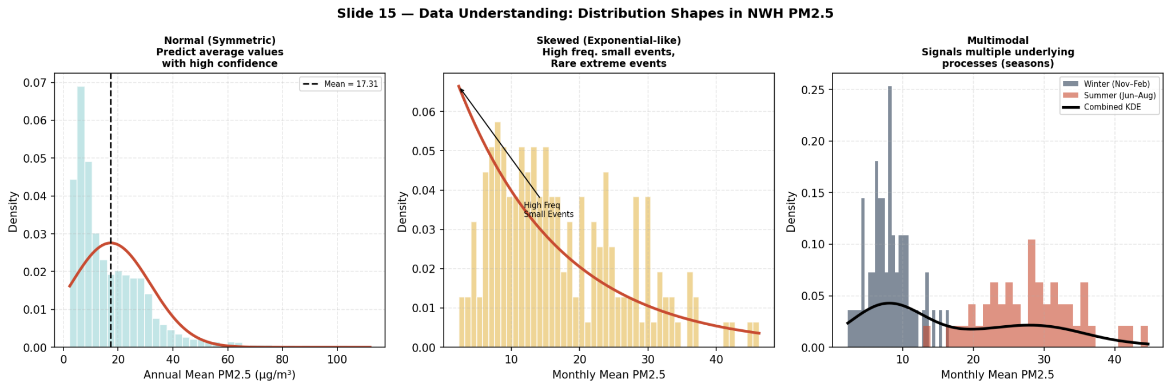
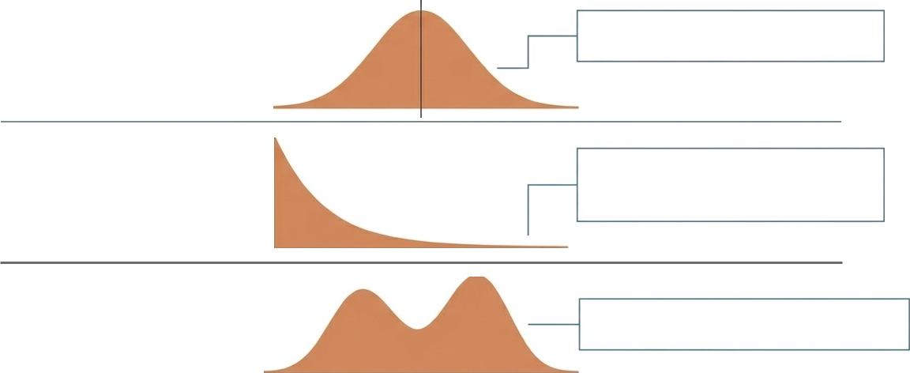
Data Understanding
Data != understanding; Raw values only documents the past; mathematical shape dictates the likelihood of the future
Normal (Symmetric): Predict average values with very high confidence
High Frequency
Small Events
Skewed (e.g., Exponential): Expect more small events, and rare but highly impactful massive events.
Rare, Highly Impactful events
Multimodal: Signals that multiple distinct underlying models/processes are at play.
Pro-Tip: A multimodal distribution is almost always a red flag that you have a hidden categorical confounding variable. Isolate and segment it before modeling.

Slide 17





The Analytical Core: Finding the best Fitting - Distribution
The 5-Step Distribution Fitting Framework
Step 1
Visual Inspection
(First Look)
Use plots to get an initial sense
Step 2
Fit Common Distribution
Use scipy.stats to fit multiple candidate distributions:
Step 3
Goodness-of-Fit Tests
Kolmogorov–Smirnov (K-S) Test
Step 4
Q-Q (Quantile-Quantile Plot)
Check linearity between theoretical & empirical quantiles
Step 5
Use Distribution Fitting Libraries
Try the fitter package for automated comparison
Pro-Tip: Never skip Step 1. Automated algorithms might mathematically fit a unimodal normal curve to your data, completely blinding you to the fact that your underlying data is fundamentally bimodal.

Slide 18
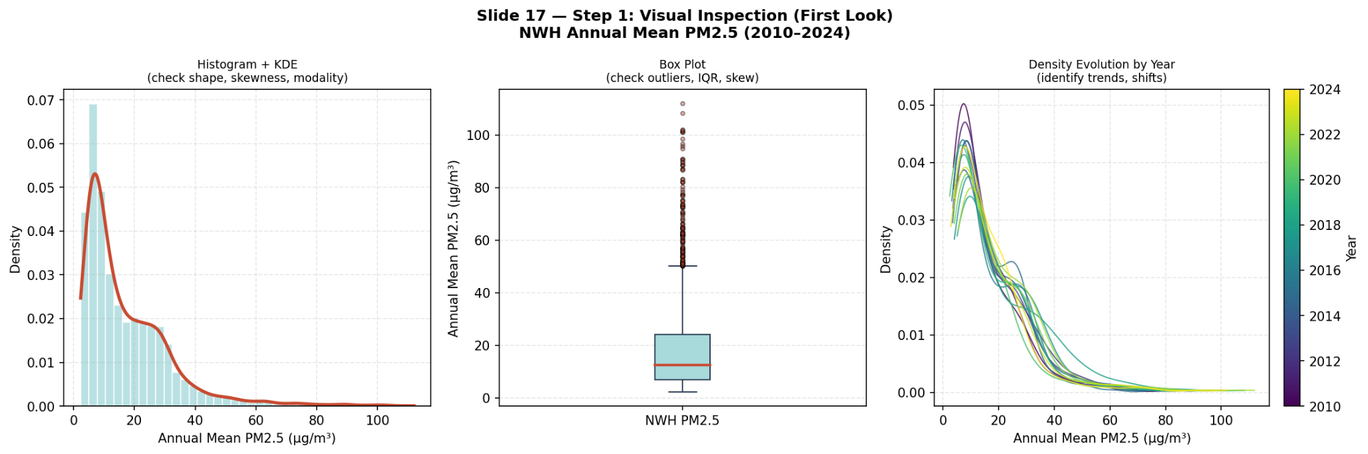
Step 1: Visual Inspection ( The First Look)
Objective:
Get an initial sense of the data's shape and spread.
How:
Use histograms, box plots, or density plots. Identify skewness, modality, and outliers.

Slide 19
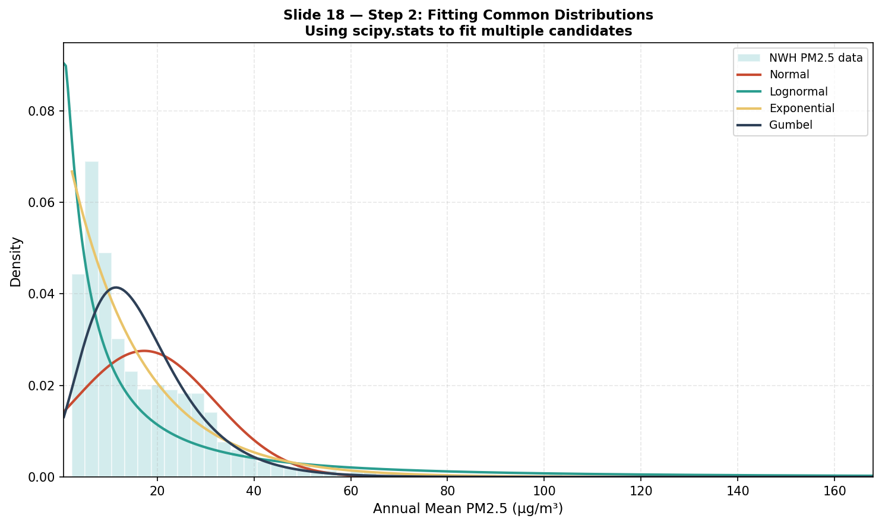
Step 2: Fitting Common Distributions
Objective:
Try fitting known distributions to the data.
Implementation:
Use scipy.stats to fit and extract parameters.

Slide 20
Step 3: Goodness-of-Fit Tests
Objective:
Check how well a theoretical distribution matches data.
Common Tests:
Kolmogorov–Smirnov (K–S) Test
Anderson–Darling Test
Chi-Square Test.

Slide 21
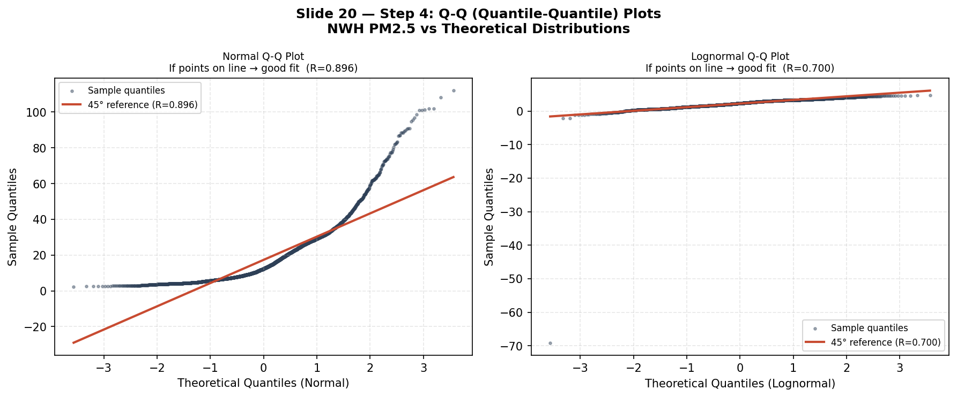
Step 4: Q-Q (Quantile-Quantile) Plot
Objective:
Compare quantiles of the sample vs. theoretical distribution.
Insight:
If points lie on the 45° line, the fit is good.

Slide 22
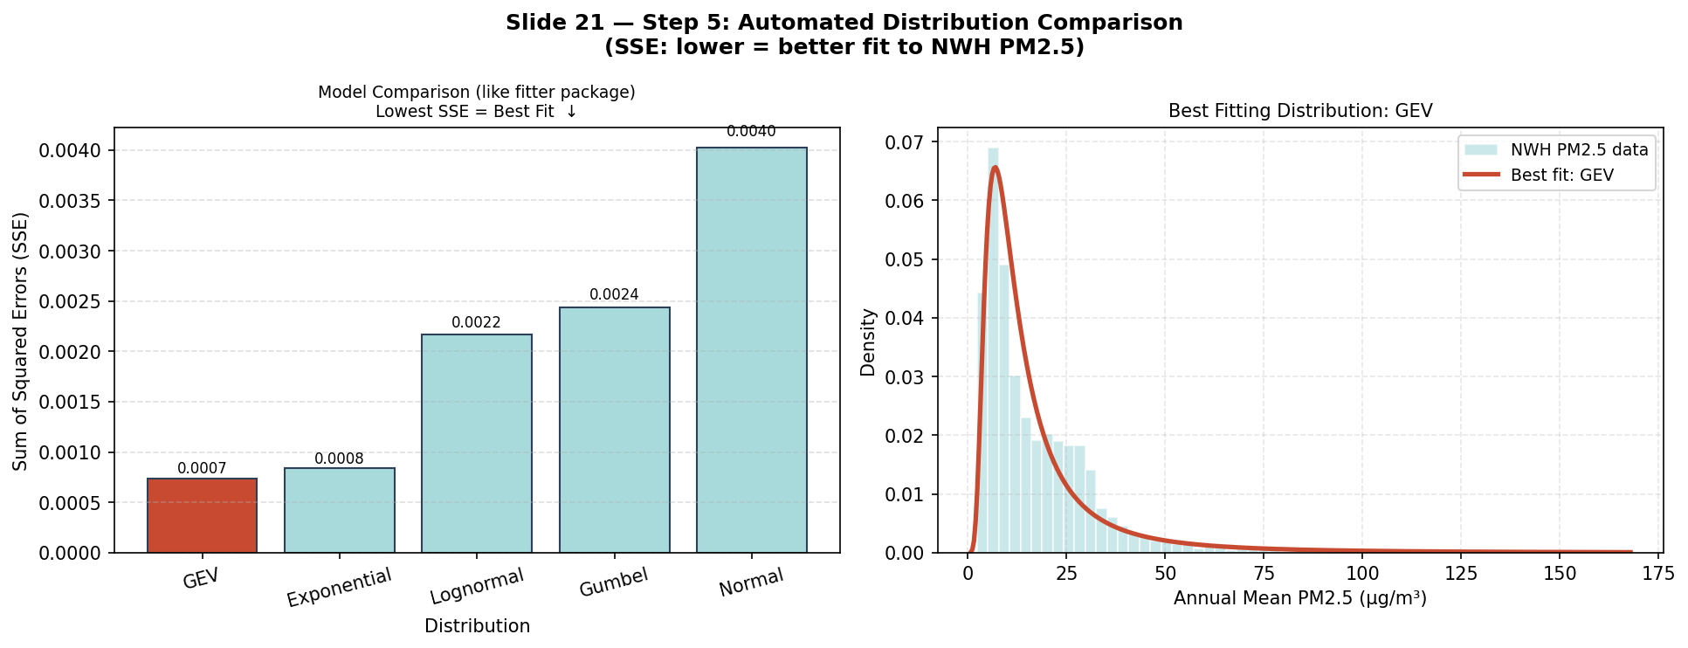
Step 5: Use Distribution Fitting Libraries
Objective:
Use automated tools to compare many distributions efficiently.
Tools:
Fitter distfit, scikit-gof.

Slide 23
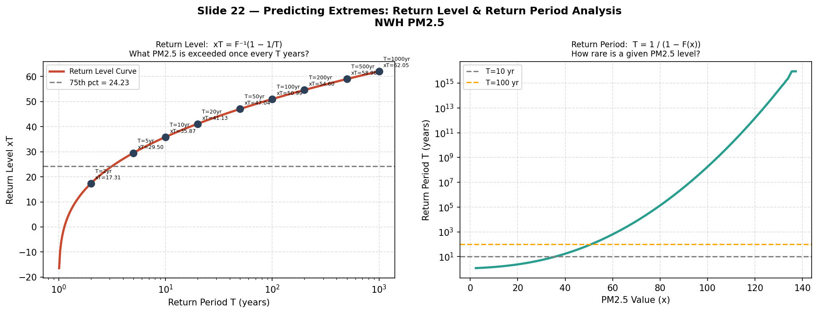
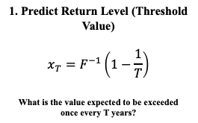
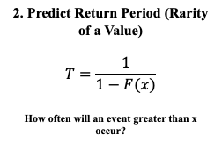
Predicting Extremes
Any Distribution with a well-defined inverse CDF (quantile function) can be inverted to predict rare or extreme events like:
Climate Extremes ( flood, heatwaves)
Finance (losses)
Engineering (Maximum structural load capacity)
This Unlocks Return Level and Return Period Analysis
Pro-Tip: The inverse CDF is arguably the most powerful tool in prescriptive analytics. It shifts the question from “What is the probability of a flood?” to the actionable “How high must the wall be to survive a 1-in-100 year event?”

Slide 24

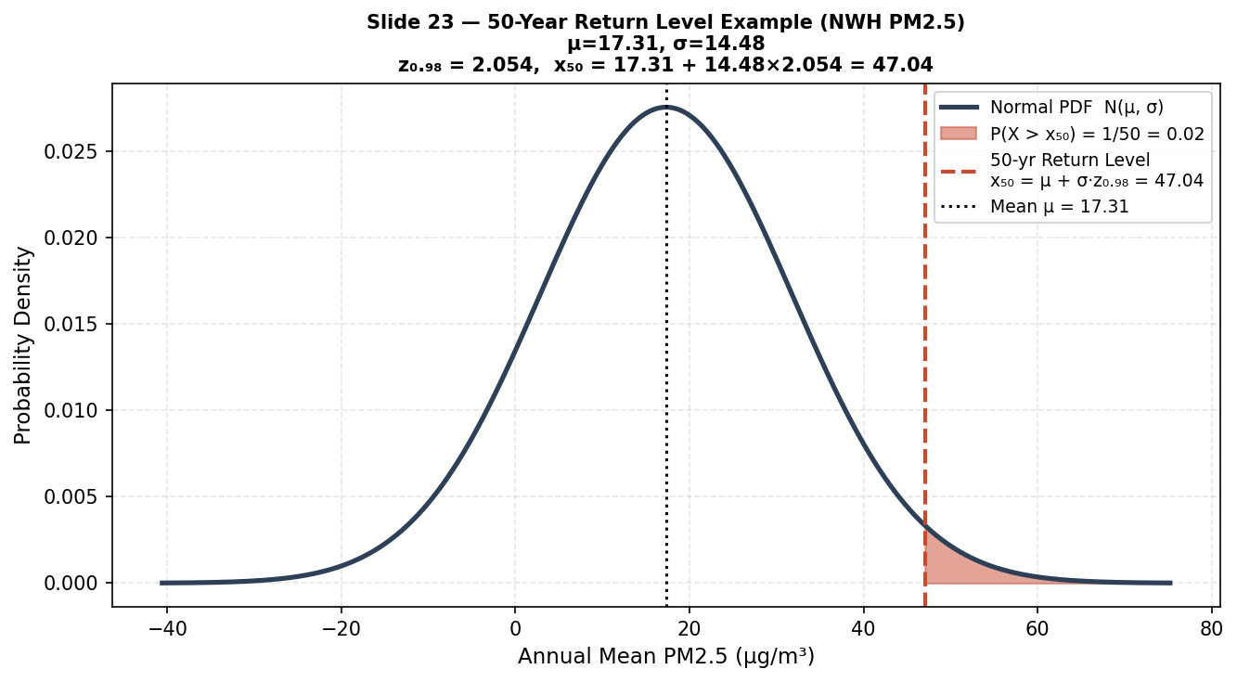
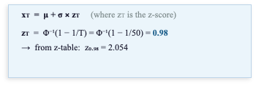

Predicting Extremes
Suppose the annual maximum daily PM_{2.5} concentration in a region follows a normal distribution with:
Pro-Tip: Inverse Cumulative Distribution Functions (ICDFs) are your ultimate bridge from abstract probability theory to concrete, actionable thresholds in risk management.

Slide 25
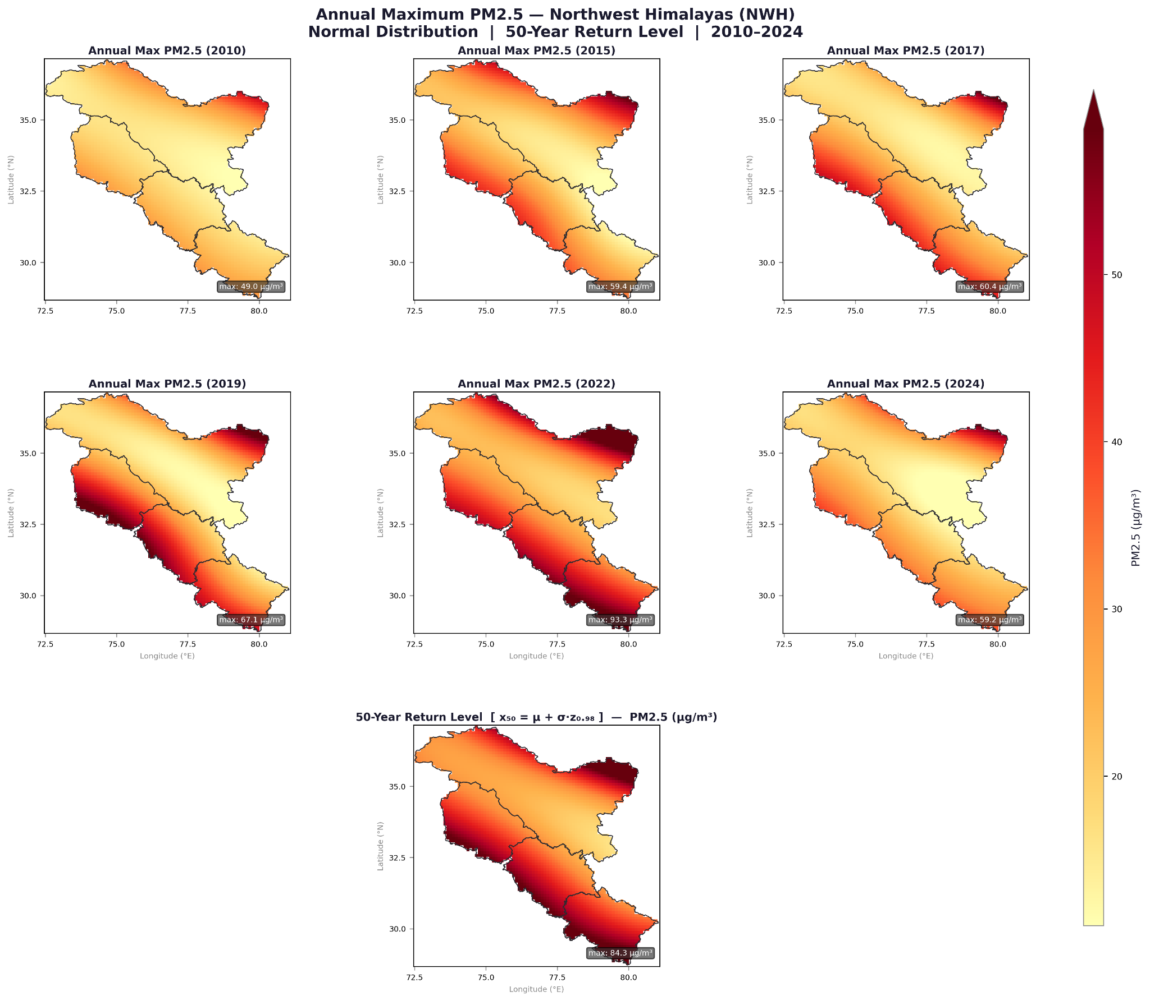

Predicting Extremes
In the maps on the right, the single-station 50-year return level idea is extended spatially across an entire region and multiple future years.
At each grid cell, Normal distribution parameters (μ, σ) are estimated from observed annual maxima, projected forward with a climate trend, and the return level x₅₀ = μ + σ·z₀.₉₈ is computed.
Warmer colors (orange → deep red) indicate higher extreme PM2.5. Progressive darkening over time reflects worsening pollution under the trend scenario.
Pro-Tip: Spatial distribution models (like Kriging combined with Extreme Value Theory) allow you to interpolate probability maps between physical sensor locations, turning point-data into comprehensive regional intelligence.

Slide 26
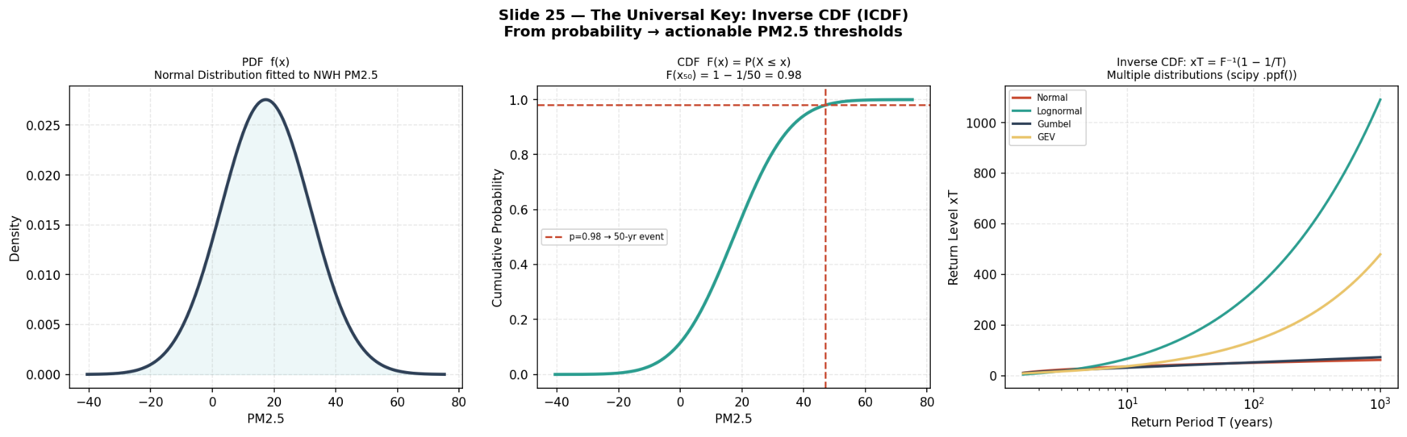
The Universal Key: Inverse CDF
Core Rule: Prediction is not restricted to one distribution; ANY invertible distribution unlocks quantile forecasting.
Distribution | Use Case | Method
Normal | General natural processes | norm.ppf, norm.cdf
Exponential | Time between events | expon.ppf, expon.cdf
Gumbel | Extremes (e.g. max rainfall) | gumbel_r.ppf, gumbel_r.cdf
GEV | Generalized extremes | genextreme.ppf, genextreme.cdf
Lognormal | Skewed data | lognorm.ppf, lognorm.cdf
You’re not restricted to just GEV — any distribution with inverse CDF can be used for prediction!
Pro-Tip: In Python’s SciPy library, the . pp:f() (Percent Point Function) is your programmatic inverse CDF. Mastering it allows you to dynamically generate robust confidence intervals for virtually any stochastic process.

Slide 27
Summary
Quantifying the Unknown
Probability provides the exact mathematical language needed to quantify uncertainty.
The Shape of Reality
Every measurable variable from human height to market income to regional rainfall possesses an inherent shape.
Revealing the Hidden
By correctly fitting a distribution to raw data, we expose underlying behavioral and systemic patterns that are invisible to the naked eye.

Slide 28
THANK YOU
Questions & Discussion

